Slide 1
Course Introduction
CS393: Database Systems

Slide 2
Lesson Objectives
Course Introduction
Set Expectations
Familiarize with tools
Intro to Databases
Define database and related key terms
Compare and contrast databases with other storage systems
Discuss advantages and disadvantages of databases

Slide 3
Course Introduction

Slide 4
Database Systems
CS393 addresses the analysis, design, implementation, and management of relational databases. Structured query language (SQL) is covered in depth along with problem and data modeling techniques. Implementation techniques and considerations are discussed and practiced extensively. Key concepts include analysis and design with standard notation, data model to logical schema conversion techniques, normalization, client-server architectures and web-based access to database systems. Students are exposed to user and privilege management, database backup and recovery, and security vulnerabilities such as SQL injection.
SQL
Data Definition
Data Modification
Queries
Integrity
Apps
Data Design
Databases from code
App design
Misc.
Security
Final Project
Other Databases

Slide 5
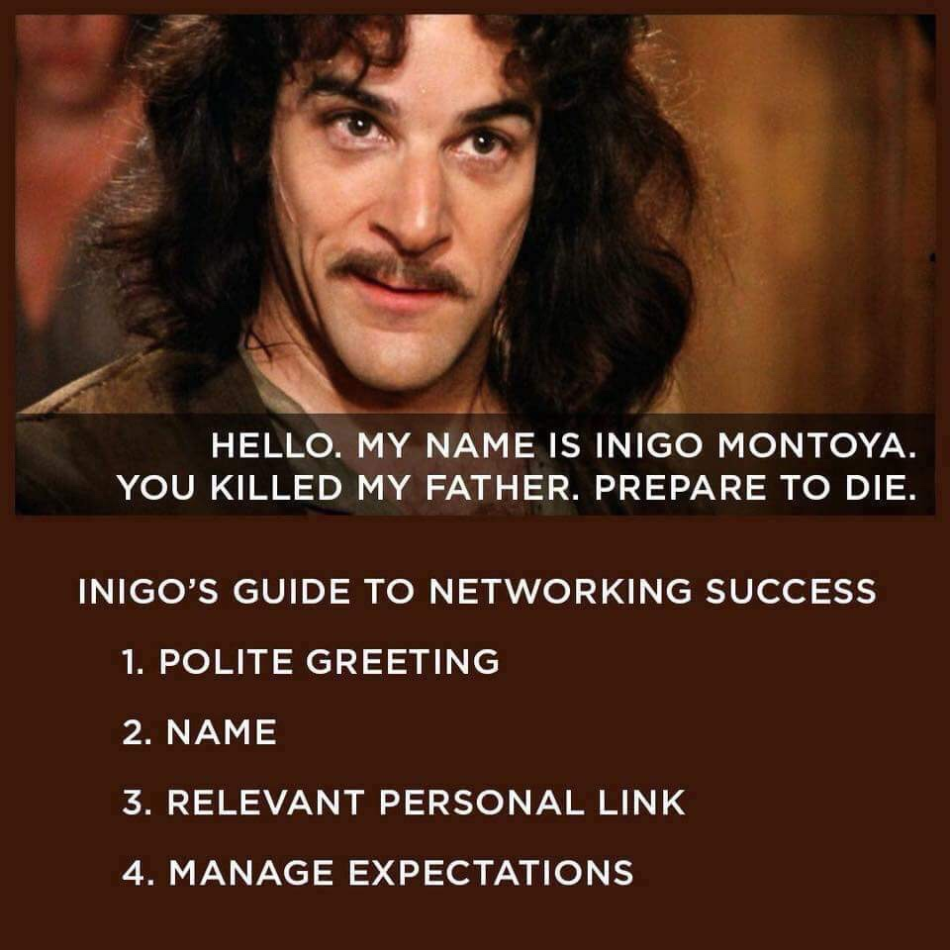
Introductions
Preferred Name
Home STATE
Cadet Company
Academic Major
Branch?
What do you do?

Slide 6

Course Expectations
From USCC SOP, October 2016:
"The primary responsibility for achieving satisfactory academic performance rests with the individual Cadet."
From Documentation of Academic Work:
"[Cadets] are required to document all graded homework and academic submissions."
Image Credit: IMDB
Notes:
You are responsible for your academic success
Document your assignments

Slide 7
Your Expectations
Notes:
What do you want out of this class?
What do you want from me?

Slide 8
Documentation
Use the ACM citation format.
A program like Zotero may help you manage sources.
Using the correct Zotero Style makes citations easy.
Provide LLM direct link to chat, not screenshots, not quotes, not images, not etc.
Document anything that is not common knowledge.
If you share your solution, CC your instructor.
[1] Claire Churcher. 2012. Beginning Database Design: From Novice To Professional (2nd ed.). Apress.
[2] Ben Forta. 2005. MySQL Crash Course. Sams.
Notes:
Anything from me, the textbook, of the course material does not need to be documented. Everything else needs to be documented
Everyone needs to read this slide in its entirety.

Slide 9

Classroom Standards
Per USCC SOP, October 2016:
No tobacco or food (includes chewing gum).
Leave coats and bags outside.
From Dean’s Operational Guidance:
"All drinks (including plain water) must have a fully sealable lid. This can be a twist cap such as on bottled drinks or a closable mechanism common on many coffee travel mugs."

Slide 10
Additional Instruction (AI)
AI Guidance:
USE THE BOOKINGS LINK
Do the required reading and in-class exercises
Know what you are going to ask and bring your computer
Get it early – do not wait until a homework is due or until the day of a WPR
Discussion rooms in Canvas for homeworks
You can email/Teams me whenever. I will try to respond quickly
Preference for in-person, but can be remote if needed

Slide 11
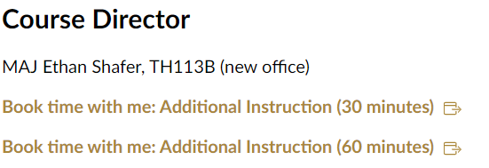
USE THE BOOKINGS LINK

Slide 12

Textbook
Image Credit: Database Systems: A Practical Approach to Design, Implementation, and Management, 6th Edition
Notes:
Additionally MySQL and Python official documentation

Slide 13
Canvas
Read the syllabus!
Modules vs Calendar vs Due Dates
Notes:
DEMO CANVAS – Overview of Syllabus, Modules
Note that each lesson shows the two sections' meeting dates, the lesson readings, assignments which are due, and assignments which will be handed out.
Lesson objectives and slides are inside each lesson plan.
Assignments will be their own tab on the left side of the page.

Slide 14
USE THE BOOKINGS LINK

Slide 15
Databases

Slide 16

The Cadet Information System
What is CIS?
Why? Where did it come from?
What’s a Cadet?
How are Cadets identified?
What’s a course?
How are courses identified?
Image Credit: West Point
Notes:
What does CIS track?
Why? -How was it designed
What’s a Cadet?
An entity
How are Cadets identified?
C Number, X Number; what else describes cadets?
What’s a course?
An entity
How are courses identified?
A Course number; what else describes courses?
What's a database application that cadets use every day?
- Facebook (OK boomer), Instagram, Jodel, Snapchat, TikTok (I hope not!)
- Cadet Information System

Slide 17
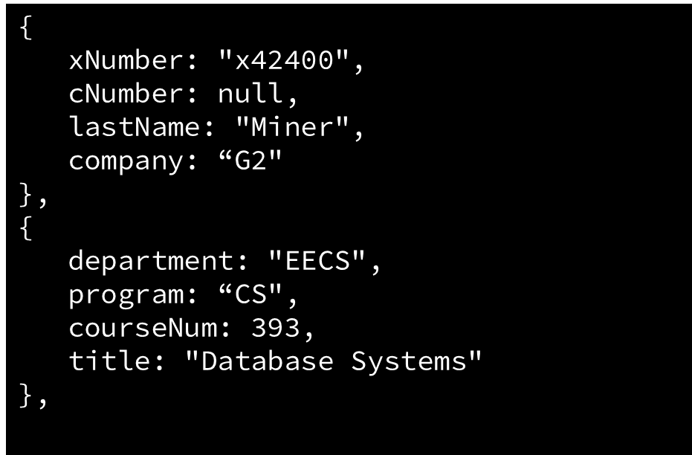
The Relational Model
Spreadsheet
JSON
X-Num | C-Num | Last Name | Company
x74665 |  | Sloan | B3
x42400 |  | Miner | G2
Notes:
Textbook describes the relational model using a table
We can represent a table in a spreadsheet as you see on the left.
Each row can be thought of as an object or entity (a specific instance) whereas the columns are attributes; a domain is the range of possible values for an attribute
We could also visualize each entity in JSON
We will talk later in the course how a spreadsheet is not an effective means of storing/retrieving data

Slide 18
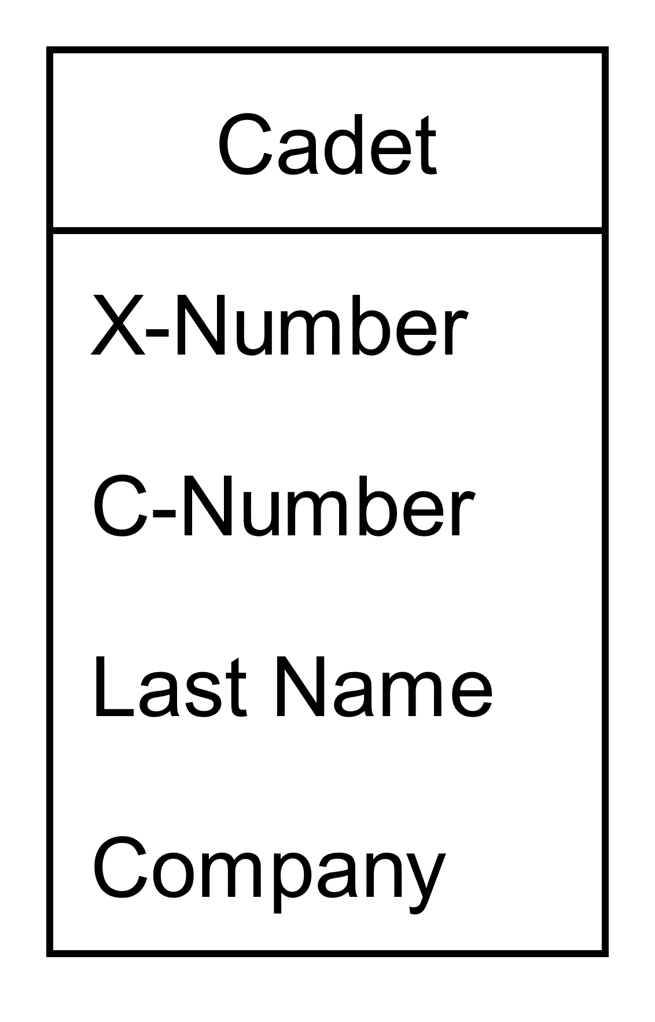
Class Diagrams
Unified Modeling Language (UML)
Top box: Type of Class
Bottom Box: Fields, Attributes
Instances of Cadets
Relationships between Entities
Notes:
We will use something called Unified Modeling Language to describe databases
In UML we use class diagrams
Cadet is a class; can think of it as the type of entity (table) we just looked at.
The bottom box are the fields of the Class; each entity or object has one of each of these fields. (can think of fields as attributes)

Slide 19
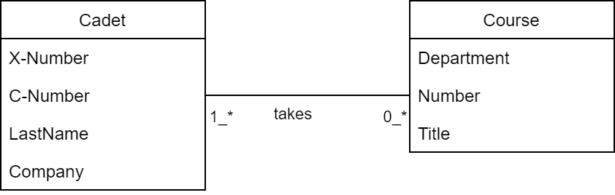
Data Model Diagram
Notes:
Here we have two entity type classes: Cadets and Course
We can use a data model diagram to represent how these entity type classes are related
For example, a cadet takes a course

Slide 20
Terms
Database: Container to store organized data
Table: Structured list of data of a specific type
Schema: Information about database and table layout and properties
Column: Single field in a table
Datatype: Type of allowed data (applied to column)
Row: Single record in a table
Primary Key: Set of columns whose values uniquely identify each row in a table
DBMS: Software system that enables users to define, create, maintain, and control access to the database
Server: Machine running DBMS with at least one database
'DBMS' definition credit:
Connolly, Thomas M.; Begg, Carolyn E. (2014). Database Systems – A Practical Approach to Design Implementation and Management (6th ed.). Pearson.
Notes:
What is a database?
Stores data (how do we do that? A file, so a database is a specific type of file (or set of files))
Makes data available
So a DBMS is software that manages databases (duh)
Within a database, what is a table? What does a table hold? How are the rows in a table related? What is schema?
What data types are you familiar with?
What type do we use most often in databases? What is a "string" called in MySQL? (char or varchar – what is the difference?)
(char is fixed length and padded with blanks; varchar is variable length)
What is a server? (Don't read from slide, what do you think of when you hear the word?)
Remote machine
Provides a service

Slide 21
Advantages & Disadvantages
Advantages
Disadvantages
?
?

Slide 22
Tools
Python (latest)
MySQL (latest)
Server
Workbench
VS Code (optional)
MySQL extension from Oracle
Draw.io
Setup database examples
In vscode, run lesson01.sql
In vscode, run lesson01 starter.mysql-notebook

Slide 23
Lesson 1 Review

